Slide 2
In the Name of
the Most Gracious the Dispenser of Grace
FEEL Legal Education Portfolio
FB: @FEELLEP
Foundation for Empowerment through Education and Leadership (FEEL) ™
Corporate Social Responsibility (CSR) ®
FEEL CSR 2020-2021 ©
wwww.feelsociety.org | info@feelsociety.org | www.facebook.com/FEELorg | www.facebook.com/FEELLEP
www.covid.gov.pk/public_service_message

Slide 3
www.covid.gov.pk/public_service_message

Slide 4
Chair and Specialism
Chairperson and Director of FEEL Legal Education Portfolio 2019
Chairperson and Director of FEEL Experiential Learning Series: Public Speaking, Professional Conduct, Advocacy Skills, Writing as a Tool for Change, Rote Learning VS Experiential Learning 2019
Chairperson and Director of An Nisa Training Centre by FEEL 2019 and Know Educate Your Self (KEYS) by FEEL, School of Thoughts and Skills
Chairperson and Director of FEEL for Kasur – An Open Dialogue – Zainab Alert Response and Recovery Act 2020 and Zainab Alert App
Chairperson and Head of LAWIT@FEEL 2021
Chairperson and Head of FEEL CSR 2021
Chairperson and Head of FEEL ADR 2022
Specialist Consultant and Skills Trainer, National Action Plan of Islamic Republic of Pakistan,
Training Diploma for Prosecutors, Anti-Terrorism Act 1997 (Expert Level)
Specialist Consultant and Skills Trainer, Government Delegates, National and International Assignments (Expert Level)
Specialist Consultant and Skills Trainer, Local and International Law Firms (Expert Level)
Specialist Consultant and Skills Trainer, Local and International Law Colleges and Universities (Expert Level)
Sehrish Sheikh
Profile
Presidential Business Development Team, GE Capital Europe Headquarters, United Kingdom
Ministerial Legal Redress and Policy Reform Division, Ministry of Justice, Government of United Kingdom
Honorary Advisor to Minister for Education and Training, Government of Islamic Republic of Pakistan
Honorary Advisor to Minister for Human Rights, Government of Islamic Republic of Pakistan
Faculty of Law and Policy, Local and International Colleges and Universities
Co-Founder Foundation for Empowerment through Education and Leadership (FEEL)
Arbitrator, UPIC US-Pakistan Interreligious Consortium
Founder and Director Business Development, Tranzcript Ltd.
Founder and CEO Tranzcript Training
Foundation for Empowerment through Education and Leadership (FEEL) ™
Alternative Dispute Resolution ®
FEEL ADR 2022 ©
wwww.feelsociety.org | info@feelsociety.org | www.facebook.com/FEELorg | www.facebook.com/FEELLEP
FEEL Legal Education Portfolio
FB: @FEELLEP LAWIT@FEEL
www.covid.gov.pk/public_service_message

Slide 5
FEEL ADR 2022
Case Study of Justice
Islamic Republic of Pakistan
FEEL ALTERNATIVE DISPUTE RESOLUTION 2022
FB: FEELLEP
Foundation for Empowerment through Education and Leadership (FEEL) ™
Alternative Dispute Resolution ®
FEEL ADR 2022 ©
wwww.feelsociety.org | info@feelsociety.org | www.facebook.com/FEELorg | www.facebook.com/FEELLEP
FEEL Legal Education Portfolio
FB: @FEELLEP LAWIT@FEEL
FEEL Legal Education Portfolio
FB: @FEELLEP LAWIT@FEEL
www.covid.gov.pk/public_service_message

Slide 6
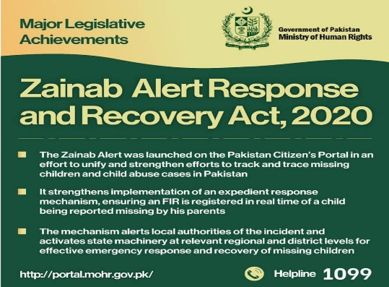
FEEL ADR 2023
Case Study of Women’s Right to Vote
Islamic Republic of Pakistan
FEEL ALTERNATIVE DISPUTE RESOLUTION
FB: FEELLEP
FEEL ADR 2023
Policy and Guidelines
Women’s voting rights in the electoral process of Islamic Republic of Pakistan
Education, Objectives and Solutions proposed by Educationalists and Professionals
Zainab Alert Response and Recovery Act 2020
Introduction of Specialized Workshops through Experiential Learning and Teaching Techniques on Zainab Alert Response and Recovery Act 2020 and Zainab Alert App
Foundation for Empowerment through Education and Leadership (FEEL) ™
Alternative Dispute Resolution ®
FEEL ADR 2022 ©
wwww.feelsociety.org | info@feelsociety.org | www.facebook.com/FEELorg | www.facebook.com/FEELLEP
FEEL Legal Education Portfolio
FB: @FEELLEP LAWIT@FEEL
FEEL Legal Education Portfolio
FB: @FEELLEP LAWIT@FEEL
www.covid.gov.pk/public_service_message

Slide 7
FEEL ADR 2023
Case Study of Women’s Right to Vote
Islamic Republic of Pakistan
FEEL ALTERNATIVE DISPUTE RESOLUTION
FB: FEELLEP
FEEL ADR 2023
Policy and Guidelines
FEEL Alternative Dispute Resolution (ADR) is a platform that provides education through policy, procedure, policing, law and justice which also enables us to empower through the competent authorities delivering at local and international industry standards and best practices.
Action Plan 2022
Policy and Procedure Literacy (online & offline)
Skills Literacy Taskforce (soft & professional)
Literacy Fund (research & programmes)
Competent Authorities (tangible & intangible)
Foundation for Empowerment through Education and Leadership (FEEL) ™
Alternative Dispute Resolution ®
FEEL ADR 2022 ©
wwww.feelsociety.org | info@feelsociety.org | www.facebook.com/FEELorg | www.facebook.com/FEELLEP
FEEL Legal Education Portfolio
FB: @FEELLEP LAWIT@FEEL
FEEL Legal Education Portfolio
FB: @FEELLEP LAWIT@FEEL
www.covid.gov.pk/public_service_message

Slide 8
FEEL ADR 2023
Islamic Republic of Pakistan
FEEL ALTERNATIVE DISPUTE RESOLUTION
FB: FEELLEP
Our Aim
Education, Objectives and Solutions proposed
by Educationalists and Professionals
Inheritance Rights Between Siblings
According to Islamic Law (New Legislation)
Zainab Alert Response and Recovery Act 2020
Increasing the threshold of women voters
in rural areas of Punjab
Policy and Procedure Literacy (online & offline)
Skills Literacy Taskforce (soft & professional)
Literacy Fund (research & programmes)
Competent Authorities (tangible & intangible)
Foundation for Empowerment through Education and Leadership (FEEL) ™
Alternative Dispute Resolution ®
FEEL ADR 2023 ©
wwww.feelsociety.org | info@feelsociety.org | www.facebook.com/FEELorg | www.facebook.com/FEELLEP
FEEL Legal Education Portfolio
FB: @FEELLEP LAWIT@FEEL
FEEL Legal Education Portfolio
FB: @FEELLEP LAWIT@FEEL
www.covid.gov.pk/public_service_message

Slide 9
FEEL ADR 2022
Case Study of Rights
Islamic Republic of Pakistan
Literacy Fund (research & programmes)
Competent Authorities (tangible & intangible)
FEEL ALTERNATIVE DISPUTE RESOLUTION 2023
Policy Proposal LAWIT@FEEL ADR 2023
FB: FEELLEP
FEEL ADR 2023
Legal Writing and Drafting Programme by FEEL
Legal Writing Course
2023©
Foundation for Empowerment through Education and Leadership (FEEL) ™
Alternative Dispute Resolution ®
FEEL ADR 2022 ©
wwww.feelsociety.org | info@feelsociety.org | www.facebook.com/FEELorg | www.facebook.com/FEELLEP
FEEL Legal Education Portfolio
FB: @FEELLEP LAWIT@FEEL
FEEL Legal Education Portfolio
FB: @FEELLEP LAWIT@FEEL
www.covid.gov.pk/public_service_message

Slide 10
FEEL ADR 2022
Foundation for Empowerment through Education and Leadership (FEEL) ™
Alternative Dispute Resolution ®
FEEL ADR 2022 ©
wwww.feelsociety.org | info@feelsociety.org | www.facebook.com/FEELorg | www.facebook.com/FEELLEP
FEEL Legal Education Portfolio
FB: @FEELLEP LAWIT@FEEL
FEEL Legal Education Portfolio
FB: @FEELLEP LAWIT@FEEL
www.covid.gov.pk/public_service_message

Slide 11
FEEL ADR 2023
Public Policy FEEL ADR 2023
LAWIT@FEEL FEEL Legal Education Portfolio
INHERITANCE BETWEEN SIBLINGS ACCORDING TO ISLAMIC LAW
CONDITIONS:
NO Legal Heir in Direct Line
Unmarried
Childless
Death
1 Male: Unmarried/Childless
1 Female: Unmarried/Childless
Death: 1 half of what each leaves behind
1 Male: Unmarried/Childless
2 Females: BOTH 2/3 of what male left behind
Multiple Siblings
1 Male: 2 Females’ Share
Male
Male
Female
Female
FEEL ALTERNATIVE DISPUTE RESOLUTION
2023
Policy Proposal LAWIT@FEEL ADR 2022
FB: FEELLEP
Male
Female
Male
Female
Female
Male
Female
Male
Female
Male
Female
Foundation for Empowerment through Education and Leadership (FEEL) ™
Alternative Dispute Resolution ®
FEEL ADR 2022 ©
wwww.feelsociety.org | info@feelsociety.org | www.facebook.com/FEELorg | www.facebook.com/FEELLEP
FEEL Legal Education Portfolio
FB: @FEELLEP LAWIT@FEEL
FEEL Legal Education Portfolio
FB: @FEELLEP LAWIT@FEEL
www.covid.gov.pk/public_service_message

Slide 12
FEEL ADR 2022
Model Concept
Theatre Pind
Bedian Road Lahore
FEEL ALTERNATIVE DISPUTE RESOLUTION
2022
Policy Proposal LAWIT@FEEL ADR 2022
FB: FEELLEP
Foundation for Empowerment through Education and Leadership (FEEL) ™
Alternative Dispute Resolution ®
FEEL ADR 2022 ©
wwww.feelsociety.org | info@feelsociety.org | www.facebook.com/FEELorg | www.facebook.com/FEELLEP
FEEL Legal Education Portfolio
FB: @FEELLEP LAWIT@FEEL
FEEL Legal Education Portfolio
FB: @FEELLEP LAWIT@FEEL
www.covid.gov.pk/public_service_message

Slide 13
FEEL ADR 2022
FEEL ALTERNATIVE DISPUTE RESOLUTION
2023
Policy Proposal LAWIT@FEEL ADR 2022
FB: FEELLEP
Foundation for Empowerment through Education and Leadership (FEEL) ™
Alternative Dispute Resolution ®
FEEL ADR 2022 ©
wwww.feelsociety.org | info@feelsociety.org | www.facebook.com/FEELorg | www.facebook.com/FEELLEP
FEEL Legal Education Portfolio
FB: @FEELLEP LAWIT@FEEL
FEEL Legal Education Portfolio
FB: @FEELLEP LAWIT@FEEL
www.covid.gov.pk/public_service_message

Slide 14
FEEL ADR 2022
FEEL ALTERNATIVE DISPUTE RESOLUTION
2022
Policy Proposal LAWIT@FEEL ADR 2022
FB: FEELLEP
Foundation for Empowerment through Education and Leadership (FEEL) ™
Alternative Dispute Resolution ®
FEEL ADR 2022 ©
wwww.feelsociety.org | info@feelsociety.org | www.facebook.com/FEELorg | www.facebook.com/FEELLEP
FEEL Legal Education Portfolio
FB: @FEELLEP LAWIT@FEEL
FEEL Legal Education Portfolio
FB: @FEELLEP LAWIT@FEEL
www.covid.gov.pk/public_service_message

Slide 15
FEEL ADR 2022
Public Policy FEEL ADR 2022
LAWIT@FEEL FEEL Legal Education Portfolio
Competent Authority
Intangible Property
Tangible Property
FEEL ALTERNATIVE DISPUTE RESOLUTION
2022
Policy Proposal LAWIT@FEEL ADR 2022
FB: FEELLEP
Foundation for Empowerment through Education and Leadership (FEEL) ™
Alternative Dispute Resolution ®
FEEL ADR 2022 ©
wwww.feelsociety.org | info@feelsociety.org | www.facebook.com/FEELorg | www.facebook.com/FEELLEP
FEEL Legal Education Portfolio
FB: @FEELLEP LAWIT@FEEL
FEEL Legal Education Portfolio
FB: @FEELLEP LAWIT@FEEL
www.covid.gov.pk/public_service_message

Slide 16
FEEL ADR 2022
Public Policy FEEL ADR 2022
LAWIT@FEEL FEEL Legal Education Portfolio
Law and Policy
Surah An Nisa (Women) Ayat 176 Quranic Fatwa (Legal Ruling)
Council of Islamic Ideology, Islamic Republic of Pakistan
Federal Ombudspersons Office, Islamic Republic of Pakistan
Ministry of Human Rights, Islamic Republic of Pakistan
Legislation and Translation
Arabic
Urdu
English
Other Languages (local and international)
FEEL ALTERNATIVE DISPUTE RESOLUTION
2022
Policy Proposal LAWIT@FEEL ADR 2022
FB: FEELLEP
Foundation for Empowerment through Education and Leadership (FEEL) ™
Alternative Dispute Resolution ®
FEEL ADR 2022 ©
wwww.feelsociety.org | info@feelsociety.org | www.facebook.com/FEELorg | www.facebook.com/FEELLEP
FEEL Legal Education Portfolio
FB: @FEELLEP LAWIT@FEEL
FEEL Legal Education Portfolio
FB: @FEELLEP LAWIT@FEEL
www.covid.gov.pk/public_service_message

Slide 17
FEEL ADR 2022
Public Policy FEEL ADR 2022
LAWIT@FEEL FEEL Legal Education Portfolio
Policy and Procedure
Objectives
Formulation of a holistic policy for the urban and rural areas of Pakistan
Implementation of the succeeding procedures, frameworks, regulations and laws through federal and provincial governments and relevant authorities
Regular reviews and reforms in the policy as per trends and public interests
2. Challenges
Inadequate legal redress and policy reforms
Inconsistency in implementation and compliance of regulations
Illiteracy and lack of basic human rights
3. Solutions
Accessibility of information (language & positioning)
Accessibility to immediate redress (legal & authoritative)
Accessibility to disclosure (information & location)
FEEL ALTERNATIVE DISPUTE RESOLUTION
2022
Policy Proposal LAWIT@FEEL ADR 2022
FB: FEELLEP
Foundation for Empowerment through Education and Leadership (FEEL) ™
Alternative Dispute Resolution ®
FEEL ADR 2022 ©
wwww.feelsociety.org | info@feelsociety.org | www.facebook.com/FEELorg | www.facebook.com/FEELLEP
FEEL Legal Education Portfolio
FB: @FEELLEP LAWIT@FEEL
FEEL Legal Education Portfolio
FB: @FEELLEP LAWIT@FEEL
www.covid.gov.pk/public_service_message

Slide 18
FEEL ADR 2022
FEEL ALTERNATIVE DISPUTE RESOLUTION
2022
Policy Proposal LAWIT@FEEL ADR 2022
FB: FEELLEP
LAWIT@FEEL (FEEL Legal Education Portfolio)
Doctor ‘imprisons, tortures’ sister for four years to deny inheritance in Lahore reported January 14, 2021
https://tribune.com.pk/story/2279988/doctor-imprisons-tortures-sister-for-four-years-to-deny-inheritance-in-lahore
Prime Minister Imran Khan of Islamic Republic of Pakistan addresses the 48th Session of the OIC Council of Foreign Ministers March 22, 2022
https://www.youtube.com/watch?v=wQSOVD5zaZs
Foundation for Empowerment through Education and Leadership (FEEL) ™
Alternative Dispute Resolution ®
FEEL ADR 2022 ©
wwww.feelsociety.org | info@feelsociety.org | www.facebook.com/FEELorg | www.facebook.com/FEELLEP
FEEL Legal Education Portfolio
FB: @FEELLEP LAWIT@FEEL
FEEL Legal Education Portfolio
FB: @FEELLEP LAWIT@FEEL
www.covid.gov.pk/public_service_message

Slide 19
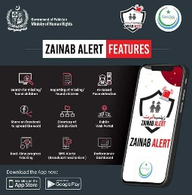
FEEL ADR 2022
FEEL ALTERNATIVE DISPUTE RESOLUTION
2022
Policy Proposal LAWIT@FEEL ADR 2022
FB: FEELLEP
Legal Aid & Justice Authority Act 2020
Foundation for Empowerment through Education and Leadership (FEEL) ™
Alternative Dispute Resolution ®
FEEL ADR 2022 ©
wwww.feelsociety.org | info@feelsociety.org | www.facebook.com/FEELorg | www.facebook.com/FEELLEP
FEEL Legal Education Portfolio
FB: @FEELLEP LAWIT@FEEL
FEEL Legal Education Portfolio
FB: @FEELLEP LAWIT@FEEL
www.covid.gov.pk/public_service_message

Slide 20
FEEL ADR 2022
FEEL ALTERNATIVE DISPUTE RESOLUTION
2022
Policy Proposal LAWIT@FEEL ADR 2022
FB: FEELLEP
Council For Islamic Ideology, Islamic Republic of Pakistan
Points of Discussion
Inheritance Laws between Siblings (Islamic – NOT sects based) – Surah An Nisa Ayat No. 179 The Noble Quran
Women’s Voting Rights (Demographic – NOT castes based) – Legislation and Policy
Children’s Protection Rights (Fundamental – NOT gender based) – Acts and Apps
Foundation for Empowerment through Education and Leadership (FEEL) ™
Alternative Dispute Resolution ®
FEEL ADR 2022 ©
wwww.feelsociety.org | info@feelsociety.org | www.facebook.com/FEELorg | www.facebook.com/FEELLEP
FEEL Legal Education Portfolio
FB: @FEELLEP LAWIT@FEEL
FEEL Legal Education Portfolio
FB: @FEELLEP LAWIT@FEEL
www.covid.gov.pk/public_service_message

Slide 21
FEEL ADR 2022
FEEL ALTERNATIVE DISPUTE RESOLUTION
2022
Policy Proposal LAWIT@FEEL ADR 2022
FB: FEELLEP
Office of Ombudsman, Government of Punjab
Points of Discussion
Women’s Rights Violations (Inheritance – NOT guardianship based) Mental Health Centres
Torture and Harassment (Physical – NOT abstract based) Drugs and Procedures
Tangible and Intangible Property (Rights – NOT favor based) Personal and Business
Foundation for Empowerment through Education and Leadership (FEEL) ™
Alternative Dispute Resolution ®
FEEL ADR 2022 ©
wwww.feelsociety.org | info@feelsociety.org | www.facebook.com/FEELorg | www.facebook.com/FEELLEP
FEEL Legal Education Portfolio
FB: @FEELLEP LAWIT@FEEL
FEEL Legal Education Portfolio
FB: @FEELLEP LAWIT@FEEL
www.covid.gov.pk/public_service_message

Slide 22
FEEL ADR 2022
FEEL ALTERNATIVE DISPUTE RESOLUTION
2022
Policy Proposal LAWIT@FEEL ADR 2022
FB: FEELLEP
FEEL Corporate Social Responsibility (CSR)
Is a platform that provides education on
Inheritance Laws and Public Policy
Electoral Policy and Women’s Rights to Vote
Rights Based Legislation and Information Technology
Foundation for Empowerment through Education and Leadership (FEEL) ™
Alternative Dispute Resolution ®
FEEL ADR 2022 ©
wwww.feelsociety.org | info@feelsociety.org | www.facebook.com/FEELorg | www.facebook.com/FEELLEP
FEEL Legal Education Portfolio
FB: @FEELLEP LAWIT@FEEL
FEEL Legal Education Portfolio
FB: @FEELLEP LAWIT@FEEL
www.covid.gov.pk/public_service_message

Slide 23
FEEL ADR 2022
FEEL ALTERNATIVE DISPUTE RESOLUTION
2022
Policy Proposal LAWIT@FEEL ADR 2022
FB: FEELLEP
FEEL Alternative Dispute Resolution (ADR)
Is a platform that provides education on
Law and Procedure
Policy and Policing
Legal Aid and Justice
Foundation for Empowerment through Education and Leadership (FEEL) ™
Alternative Dispute Resolution ®
FEEL ADR 2022 ©
wwww.feelsociety.org | info@feelsociety.org | www.facebook.com/FEELorg | www.facebook.com/FEELLEP
FEEL Legal Education Portfolio
FB: @FEELLEP LAWIT@FEEL
FEEL Legal Education Portfolio
FB: @FEELLEP LAWIT@FEEL
www.covid.gov.pk/public_service_message

Slide 24
FEEL ADR 2022
FEEL ALTERNATIVE DISPUTE RESOLUTION
2022
Policy Proposal LAWIT@FEEL ADR 2022
FB: FEELLEP
Public Policy FEEL ADR 2023
Law and Procedure
Policy and Policing
Legal Aid and Justice
Inheritance between siblings according to Islamic Law
Foundation for Empowerment through Education and Leadership (FEEL) ™
Alternative Dispute Resolution ®
FEEL ADR 2022 ©
wwww.feelsociety.org | info@feelsociety.org | www.facebook.com/FEELorg | www.facebook.com/FEELLEP
FEEL Legal Education Portfolio
FB: @FEELLEP LAWIT@FEEL
FEEL Legal Education Portfolio
FB: @FEELLEP LAWIT@FEEL
www.covid.gov.pk/public_service_message

Slide 25
FEEL ADR 2022
Public Policy FEEL ADR 2022
Law and Procedure
Police and Policing
Legal Aid and Justice
Inheritance between siblings according to Islamic Law
Ministry of Human Rights, Federal Government, Islamic Republic of Pakistan
Legal Advice on Human Rights Violations Helpline (1099)
Legal advice to be provided by the helpline taskforce with regards to Islamic Law of Inheritance between Siblings
Capacity building of the taskforce to provide Immediate Redressal in case of Violations of Human Rights Against Women regarding their Inheritance Rights
FEEL ALTERNATIVE DISPUTE RESOLUTION
2022
Policy Proposal LAWIT@FEEL ADR 2022
FB: FEELLEP
Foundation for Empowerment through Education and Leadership (FEEL) ™
Alternative Dispute Resolution ®
FEEL ADR 2022 ©
wwww.feelsociety.org | info@feelsociety.org | www.facebook.com/FEELorg | www.facebook.com/FEELLEP
FEEL Legal Education Portfolio
FB: @FEELLEP LAWIT@FEEL
FEEL Legal Education Portfolio
FB: @FEELLEP LAWIT@FEEL
www.covid.gov.pk/public_service_message

Slide 26
FEEL ADR 2022
Public Policy FEEL ADR 2022
LAWIT@FEEL FEEL Legal Education Portfolio
Rights Based Legislation
Rights of Inheritance
Rights of Vote
FEEL ALTERNATIVE DISPUTE RESOLUTION
2022
Policy Proposal LAWIT@FEEL ADR 2022
FB: FEELLEP
Foundation for Empowerment through Education and Leadership (FEEL) ™
Alternative Dispute Resolution ®
FEEL ADR 2022 ©
wwww.feelsociety.org | info@feelsociety.org | www.facebook.com/FEELorg | www.facebook.com/FEELLEP
FEEL Legal Education Portfolio
FB: @FEELLEP LAWIT@FEEL
FEEL Legal Education Portfolio
FB: @FEELLEP LAWIT@FEEL
www.covid.gov.pk/public_service_message

Slide 27
FEEL ADR 2022
Mental Health – Clinical
“She added that owing to his influence, her brother had prepared documents in which she was deemed to be mentally –ill.” Shabnam added.
https://tribune.com.pk/story/2279988/doctor-imprisons-tortures-sister-for-four-years-to-deny-inheritance-in-lahore
Foundation for Empowerment through Education and Leadership (FEEL) ™
Alternative Dispute Resolution ®
FEEL ADR 2022 ©
wwww.feelsociety.org | info@feelsociety.org | www.facebook.com/FEELorg | www.facebook.com/FEELLEP
FEEL Legal Education Portfolio
FB: @FEELLEP LAWIT@FEEL
FEEL Legal Education Portfolio
FB: @FEELLEP LAWIT@FEEL
www.covid.gov.pk/public_service_message

Slide 28
FEEL ADR 2022
Mental Health – Clinical
Foundation for Empowerment through Education and Leadership (FEEL) ™
Alternative Dispute Resolution ®
FEEL ADR 2022 ©
wwww.feelsociety.org | info@feelsociety.org | www.facebook.com/FEELorg | www.facebook.com/FEELLEP
FEEL Legal Education Portfolio
FB: @FEELLEP LAWIT@FEEL
FEEL Legal Education Portfolio
FB: @FEELLEP LAWIT@FEEL
www.covid.gov.pk/public_service_message

Slide 29
FEEL ADR 2022
Public Policy FEEL ADR 2022
LAWIT@FEEL FEEL Legal Education Portfolio
FEEL ALTERNATIVE DISPUTE RESOLUTION
2022
Policy Proposal LAWIT@FEEL ADR 2022
FB: FEELLEP
Foundation for Empowerment through Education and Leadership (FEEL) ™
Alternative Dispute Resolution ®
FEEL ADR 2022 ©
wwww.feelsociety.org | info@feelsociety.org | www.facebook.com/FEELorg | www.facebook.com/FEELLEP
FEEL Legal Education Portfolio
FB: @FEELLEP LAWIT@FEEL
FEEL Legal Education Portfolio
FB: @FEELLEP LAWIT@FEEL
www.covid.gov.pk/public_service_message

Slide 30
FEEL ADR 2022
Public Policy FEEL ADR 2022
LAWIT@FEEL FEEL Legal Education Portfolio
FEEL ALTERNATIVE DISPUTE RESOLUTION
2022
Policy Proposal LAWIT@FEEL ADR 2022
FB: FEELLEP
Foundation for Empowerment through Education and Leadership (FEEL) ™
Alternative Dispute Resolution ®
FEEL ADR 2022 ©
wwww.feelsociety.org | info@feelsociety.org | www.facebook.com/FEELorg | www.facebook.com/FEELLEP
FEEL Legal Education Portfolio
FB: @FEELLEP LAWIT@FEEL
FEEL Legal Education Portfolio
FB: @FEELLEP LAWIT@FEEL
www.covid.gov.pk/public_service_message

Slide 31
FEEL ADR 2022
Public Policy FEEL ADR 2022
LAWIT@FEEL FEEL Legal Education Portfolio
FEEL ALTERNATIVE DISPUTE RESOLUTION
2022
Policy Proposal LAWIT@FEEL ADR 2022
FB: FEELLEP
Foundation for Empowerment through Education and Leadership (FEEL) ™
Alternative Dispute Resolution ®
FEEL ADR 2022 ©
wwww.feelsociety.org | info@feelsociety.org | www.facebook.com/FEELorg | www.facebook.com/FEELLEP
FEEL Legal Education Portfolio
FB: @FEELLEP LAWIT@FEEL
FEEL Legal Education Portfolio
FB: @FEELLEP LAWIT@FEEL
www.covid.gov.pk/public_service_message

Slide 32
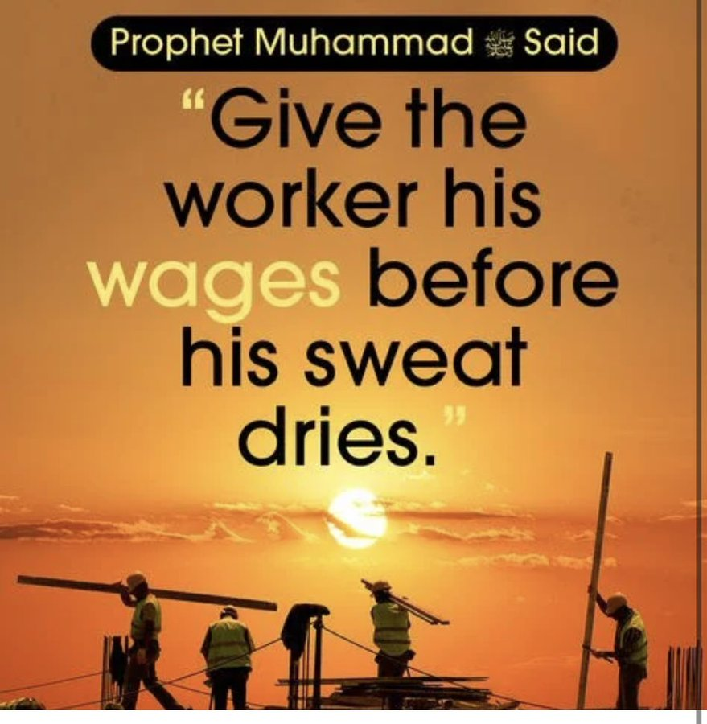
FEEL ADR 2023
1st May 2022
Reviving Sunnah
FEEL ALTERNATIVE DISPUTE RESOLUTION
2022
Policy Proposal LAWIT@FEEL ADR 2022
FB: FEELLEP
International Labour Day
1st May 2023
Public Policy
LAWIT@FEEL
Foundation for Empowerment through Education and Leadership (FEEL) ™
Alternative Dispute Resolution ®
FEEL ADR 2022 ©
wwww.feelsociety.org | info@feelsociety.org | www.facebook.com/FEELorg | www.facebook.com/FEELLEP
FEEL Legal Education Portfolio
FB: @FEELLEP LAWIT@FEEL
FEEL Legal Education Portfolio
FB: @FEELLEP LAWIT@FEEL
www.covid.gov.pk/public_service_message

